Slide 1
Statistical Constituency Parsing
Jurafsky and Martin Chapter 14
Based on slides from Sameer Singh,Dan Jurafsky, Noah Smith, Slav Petrov, and everyone else they copied from.

Slide 2
Recap: CKY Algorithm
CKY uses a two-dimensional matrix to encode the structure of a tree.
For a sentence of length n, we will use an (n + 1) × (n + 1) matrix.
You can think of the indexes as pointing at the gaps between the input words.
All constituents that can span positions i through j of the input will be stored in the cell [i,j]
Book
the
flight
through
TWA
0
1
2
3
4
5
VP, NP
Det
Nom
NP
S
will be stored in cell [1,3]
will be stored in cell [0,1]
will be stored in cell [0,3]
Notes:
01, S VP Verb Nom Noun; 12, Det; 23 Nom N; 3,4 Prep; 4,5 NP, Proper
13 NP; 35 PP;
03, S, VP, X2; 25, Nom
15 NP
05 X2, VP, VP, S(01,15), S(03,35,X2 PP), S(03,35,VP PP)

Slide 3
Recap: CKY Algorithm
j
Book
the
flight
through
TWA
Book
the
flight
through
TWA
0
1
2
3
4
5
[0,1]
[0,2]
[0,3]
[0,4]
[0,5]
VP, NP
Det
Nom
NP
[1,2]
[1,3]
[1,4]
[1,5]
S
will be stored in cell [1,3]
[2,3]
[2,4]
[2,5]
will be stored in cell [0,1]
[3,4]
[3,5]
will be stored in cell [0,3]
i
[4,5]
We only work with the upper-triangular portion of the (n + 1) × (n + 1) matrix. Each cell [i, j] records all non-terminals that can span positions i through j of the input.
Notes:
01, S VP Verb Nom Noun; 12, Det; 23 Nom N; 3,4 Prep; 4,5 NP, Proper
13 NP; 35 PP;
03, S, VP, X2; 25, Nom
15 NP
05 X2, VP, VP, S(01,15), S(03,35,X2 PP), S(03,35,VP PP)

Slide 4
Recap: CKY Algorithm
function CKY-PARSE(words, grammar) returns table
for j←from 1 to LENGTH(words) do for all {A | A → words[ j] ∈ grammar} table[j−1, j]←table[j−1, j] ∪ A
for i←from j−2 downto 0 do for k←i+1 to j−1 do for all {A|A → BC ∈ grammar and B ∈ table[i,k] and C ∈ table[k,j]}: table[i,j]←table[i,j] ∪ A
j
Book
the
flight
through
TWA
[0,1]
[0,2]
[0,3]
[0,4]
[0,5]
j iterates over columns
[1,2]
[1,3]
[1,4]
[1,5]
i iterates over rows
[2,3]
[2,4]
[2,5]
[3,4]
[3,5]
k iterates split points between i and j
i
[4,5]
Notes:
01, S VP Verb Nom Noun; 12, Det; 23 Nom N; 3,4 Prep; 4,5 NP, Proper
13 NP; 35 PP;
03, S, VP, X2; 25, Nom
15 NP
05 X2, VP, VP, S(01,15), S(03,35,X2 PP), S(03,35,VP PP)

Slide 5
Recap: CKY Algorithm
function CKY-PARSE(words, grammar) returns table
for j←from 1 to LENGTH(words) do record POS tags for word j in cell [j,j-1]
for i←from j−2 downto 0 do for k←i+1 to j−1 do find all rules A → BC, such that B spans i-k, C spans k-j and then record A in cell [i,j]
j
Book
the
flight
through
TWA
[0,1]
[0,2]
[0,3]
[0,4]
[0,5]
[1,2]
[1,3]
[1,4]
[1,5]
[2,3]
[2,4]
[2,5]
[3,4]
[3,5]
i
[4,5]
Notes:
01, S VP Verb Nom Noun; 12, Det; 23 Nom N; 3,4 Prep; 4,5 NP, Proper
13 NP; 35 PP;
03, S, VP, X2; 25, Nom
15 NP
05 X2, VP, VP, S(01,15), S(03,35,X2 PP), S(03,35,VP PP)

Slide 6
Find best parse
CKY parsing record ALL possible parses into the table. How do we figure out what the best parse is for a sentence?

Slide 7
Ambiguity: Which parse?
Time flies like an arrow.

Slide 8
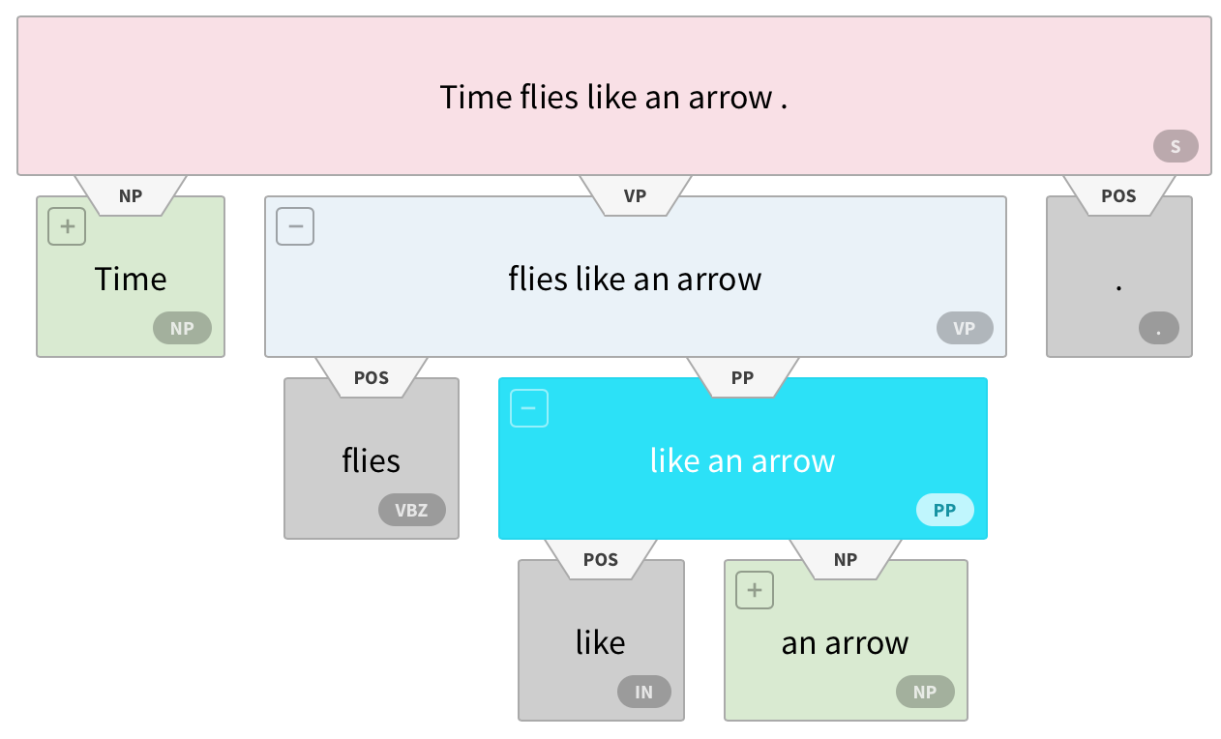
Ambiguity: Which parse?
Time flies like an arrow.
https://demo.allennlp.org/constituency-parsing
Notes:
Figure from https://demo.allennlp.org/constituency-parsing

Slide 9
Ambiguity: Which parse?
Fruit flies like a banana.

Slide 10
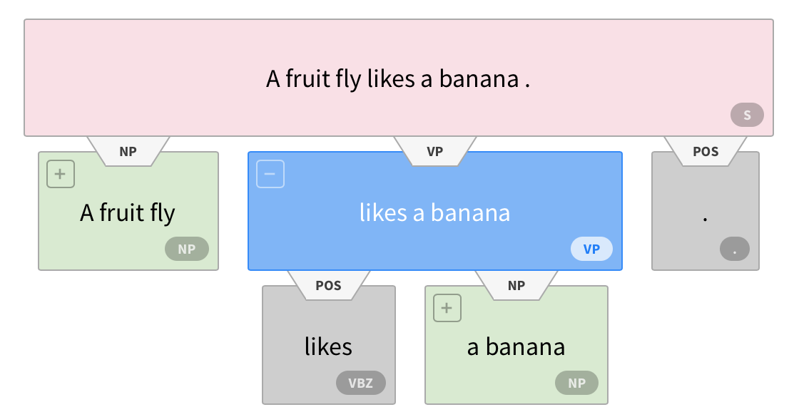
Ambiguity: Which parse?
Fruit flies like a banana.

Slide 11
Ambiguity: Which parse?
Fruit flies like a banana.

Slide 12
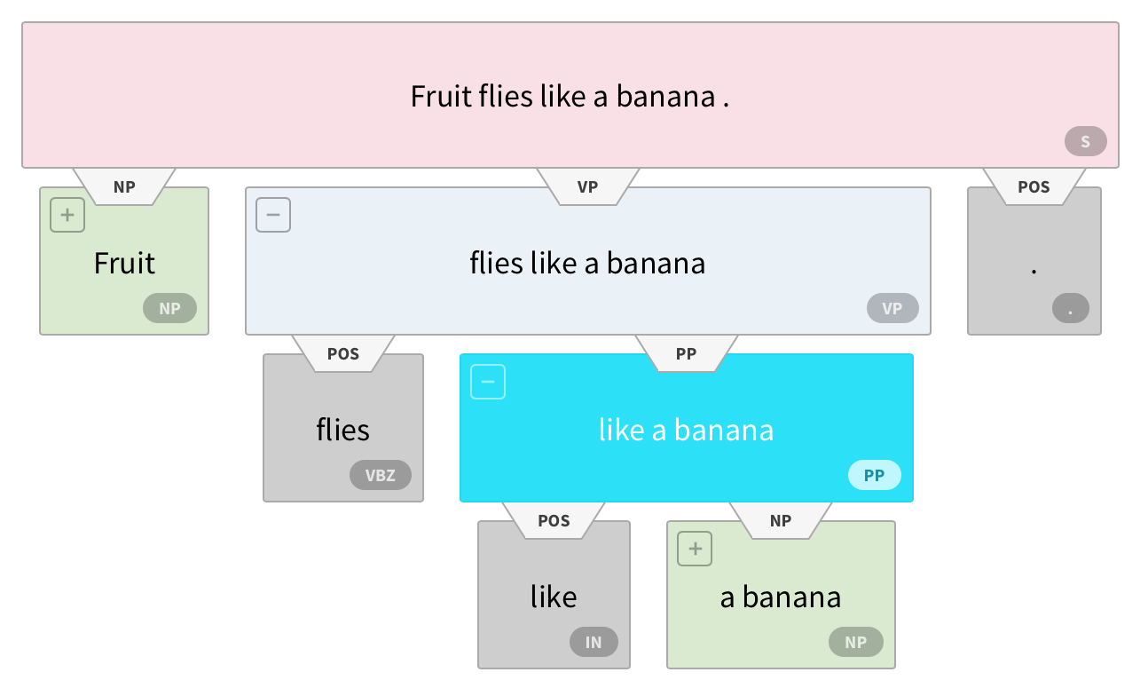
Ambiguity: Which parse?
Fruit flies like a banana.

Slide 13
Ambiguity: Which parse?
Fruit flies like a banana.

Slide 14
Formal Definition of a CFG
A context-free grammar G is defined by four parameters: N, Σ, R, S
N is a set of non-terminal symbols (or variables)
In NLP, we often use the Penn Treebank tag set
Σ is set of terminal symbols
These are the words (also sometimes called the leaf nodes of the parse tree)
R is a set of production rules, each of the form A → β
S → Aux NP VP
Nominal → Nominal Gerund VP (recursive)
S is the start symbol (a non-terminal)
Notes:
CFGs are something that we study in both linguistics and computer science. In computer science we study them in courses on Automata Theory, Languages, and Computation.

Slide 15
Formal Definition of a PCFG
A PROBABILISTIC context-free grammar G is defined by four parameters: N, Σ, R, S.
R is a set of production rules, each of the form A → β [probability]
S → NP VP [0.8]
S → Aux NP VP [0.15]
S → VP [0.05]
For a rule A → B C , the probability can be represented
P(A → B C )
or
P(A → B C | A )
or
P(RHS | LHS )
Notes:
CFGs are something that we study in both linguistics and computer science. In computer science we study them in courses on Automata Theory, Languages, and Computation.

Slide 17
Probabilistic CFGs
A PCFG assigns a probability to each parse tree T of a sentence S. This is useful in disambiguation, since we can pick the most likely parse tree.
The probability of a parse T is defined as the product of the probabilities of all the rules used to expand each of the non-terminal nodes in the parse tree.

Slide 18
Probability of a parse

Slide 19
Probability of a parse

Slide 20
Find best parse = most probable parse

Slide 21
Find best parse = most probable parse

Slide 22
Finding best parse
Pick the parse with the highest probability. Consider all the possible parse trees for a given sentence S. The string of words S is called the yield of any parse tree over S.

Slide 23
Joint Probability of T and S
By definition of joint probability:
But since a parse tree includes all the words of the sentence, P(S|T ) is 1

Slide 24
Estimating the probabilities

Slide 25
Problem 1
Poor independence assumptions: CFG rules impose an independence assumption on probabilities that leads to poor modeling of structural dependencies across the parse tree.

Slide 26
Problem 2
Lack of lexical conditioning: CFG rules don’t model syntactic facts about specific words, leading to problems with subcategorization ambiguities, preposition attachment, and coordinate structure ambiguities.

Slide 27
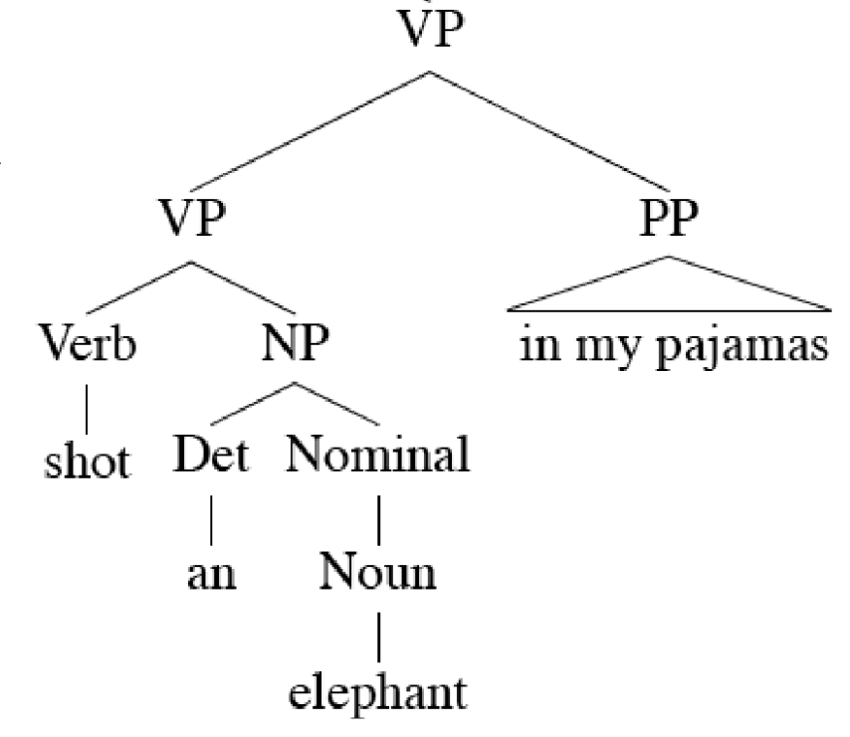
Lexicalized PCFGs
Notes:
Eat pizza with peperoni versus Eat pizza with a fork

Slide 28
Lexicalized PCFGs

Slide 29
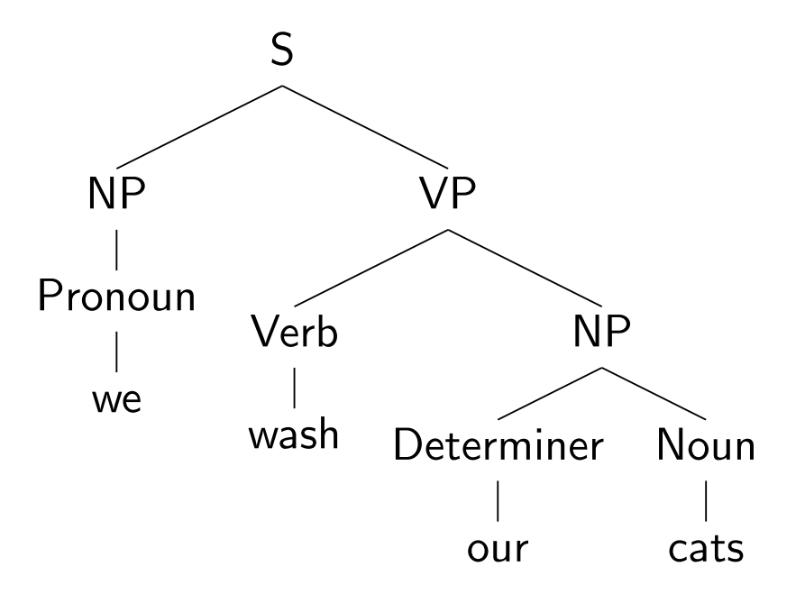
Lexicalizing a CFG

Slide 30
Lexicalizing a CFG

Slide 31
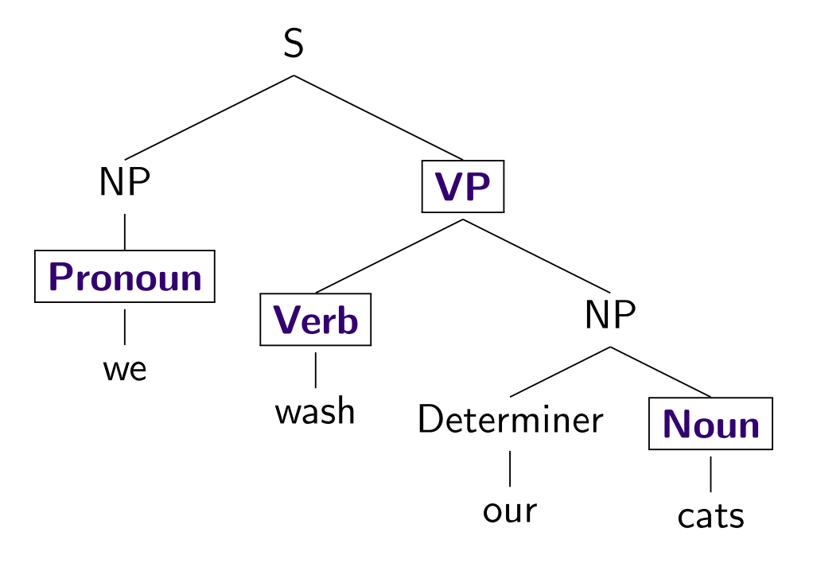
Lexicalizing a CFG

Slide 32
Lexicalizing a CFG

Slide 33
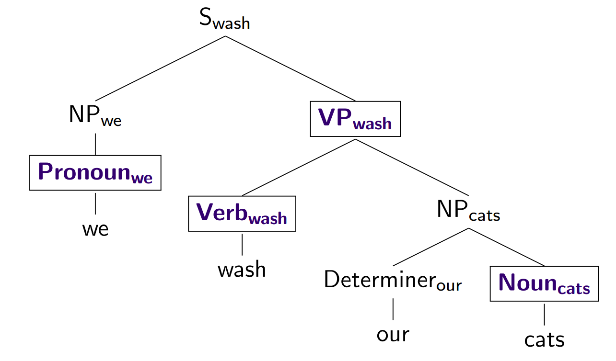
Lexicalizing a CFG

Slide 34
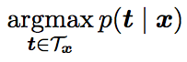
The Parsing Problem
Given sentence x and grammar G,
Recognition
Is sentence x in the grammar? If so, prove it.
“Proof” is a deduction, valid parse tree.
Parsing
Show one or more derivations for x in G.
Even with small grammars, grows exponentially!

Slide 35
Probabilistic CKY Algorithm
T[i,j,A] = Probability of the best parse with root A for the span (i,j)
A
(j-1,j)
Rule: P( A → word[j] )
Base case
T[j-1,j,A] = P(word[j] | A)
word[j]
Recursion
Rule: P( A → B C )
(i,j)
A
Try every position k, and every non-terminal pair:
B
C
T[i,j,A] = max P(B C| A) T[i,k,B] T[k,j,C]
(i,k)
(k,j)

Slide 36
Outline
Parsing: CKY Algorithm
Extensions: Probabilistic and Lexicalized
Dependency Parsing

Slide 37
Dependencies
Represent only the syntactic dependencies…

Slide 38
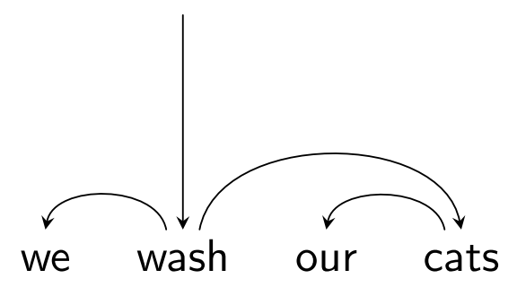
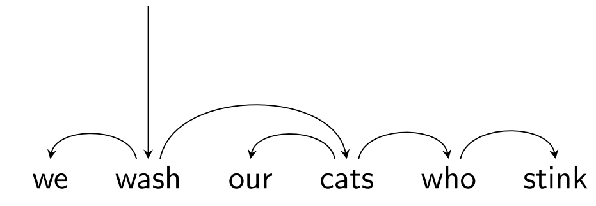
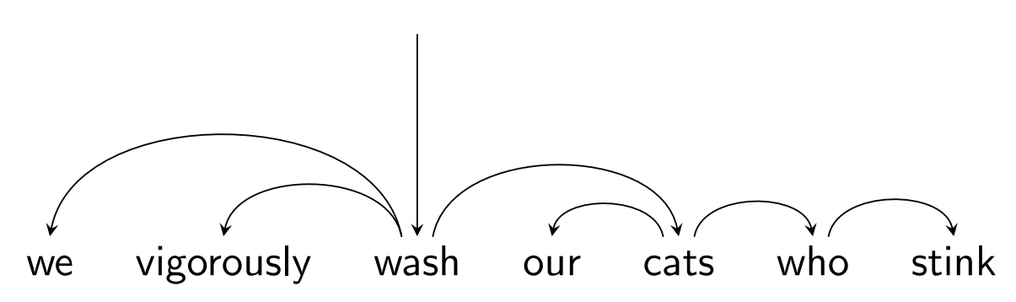
Nested Structure = Subtrees

Slide 39
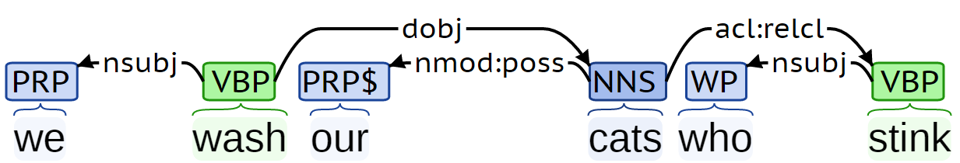
Dependency Labels

Slide 40
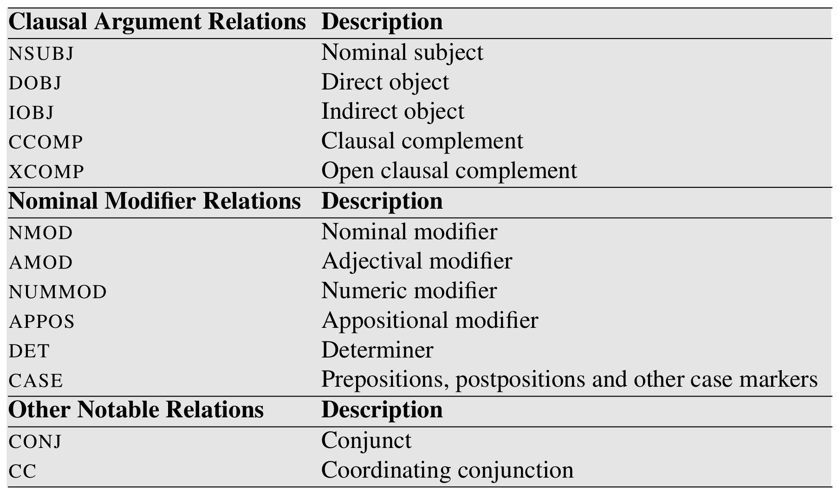
Dependency Labels

Slide 41
Dependency Trees
Notes:
Parent/head/governor, child/dependent/modifier, label/relation/type
Connected, acyclic, single-head, projective

Slide 42
Dependency Trees
Notes:
Parent/head/governor, child/dependent/modifier, label/relation/type
Connected, acyclic, single-head, projective

Slide 43
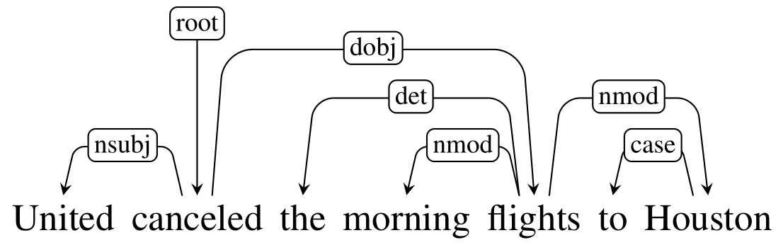
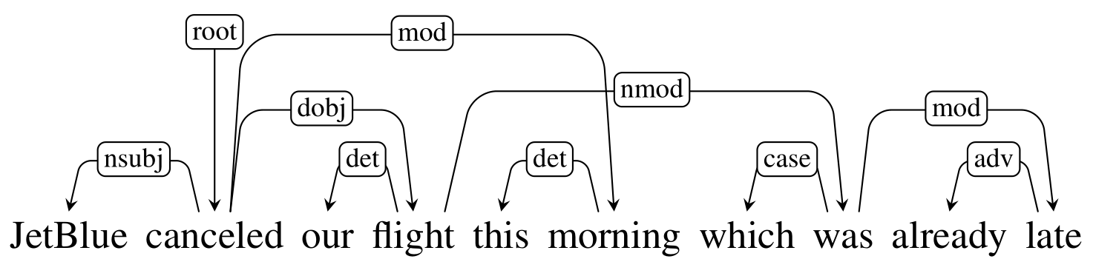
Projective vs Non-projective

Slide 44
Projective vs Non-projective

Slide 45
Evaluating Dependency Parses
ROOT She saw the video lecture
0 1 2 3 4 5
ROOT She saw the video lecture
0 1 2 3 4 5
Gold
2 She nsubj
0 saw root
5 the det
5 video nn
2 lecture dobj
Parsed
2 She nsubj
0 saw root
4 the det
5 video nsubj
2 lecture ccomp
Notes:
Labeled attachment score, unlabeled attachment score

Slide 46

Evaluating Dependency Parses
ROOT She saw the video lecture
0 1 2 3 4 5
ROOT She saw the video lecture
0 1 2 3 4 5
Gold
2 She nsubj
0 saw root
5 the det
5 video nn
2 lecture dobj
Parsed
2 She nsubj
0 saw root
4 the det
5 video nsubj
2 lecture ccomp
Notes:
Labeled attachment score, unlabeled attachment score

Slide 47
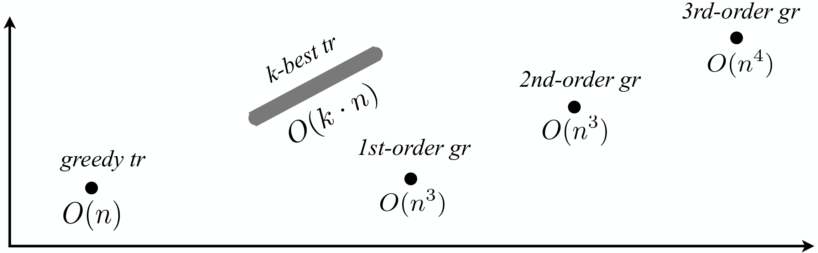
Parsing Algorithms
Transition-based
Graph-based
Fast, greedy, linear-time
Trained for greedy search
Features decide what to do next
Beam search, i.e. k-best
Slower, exhaustive algorithms
Dynamic programming, inference
Features used to score whole trees
Accuracy
Running time

Slide 48
Graph-based Parsing
Notes:
Arc-factored (1st order), 2nd order, 3rd order, and so on
Dynamic Programming for projective, MST for non-projective

Slide 49
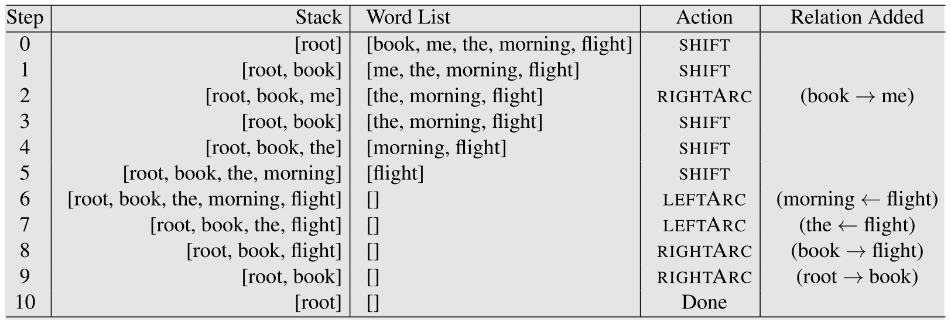
Transition-based Parsing

Slide 50
Transition-based Parsing

Slide 51
Transition-based Parsing

Slide 52
Transition-based Parsing

Slide 53
Transition-based Parsing

Slide 54
Transition-based Parsing

